Slide 1

SentimentTM Project
Sentiment Analysis Twitter Travel Destination
Notes:
Cover example with photo
Insert new photo: Delete photo on slide, click on Insert photo-icon on slide and Insert new photo. Use Crop Tool under Picture Tools to pan and zoom
To update the text, just click on the text

Slide 2



The Team
Minh Phan
Intern / DTI
Alejandro Mottini
Data Scientist / R&D
Eoin Thomas
Data Scientist / DTI
Notes:
Motivation:
TI: tool for destination, working with and understand business case
INR: classification models

Slide 3
Agenda
Project Introduction
Twitter API, Tweets Data
Project Pipeline
Classification Models
Product Prototype
Wrap-up
1
2
3
4
5
6

Slide 4
1
Project Introduction

Slide 5



Project Introduction
Travelers' sentiment?
My direct to London Bridge is cancelled... going via Blackfriars ... if you don't see me by 2:40 I got lost :/
Think the smell of microwaved fish is awful? The bus I'm on smells like that, first thing in the morning... #puke #tfl #London
London st pancras train station is the most confusing place ever. Got lost about 4 times trying to find the way out
Thing im most excited for in London? To walk across Abbey road
Hello London !! It's been a while. Looking forward to playing at the Acklam Village Market at 5pm :) @Hot_Vox
@LondonAsterino You are a beautiful Queen,London You sing like an angel You are awesome I will always believe in you I love you
#London

Slide 6

Project Introduction
Tourism locations analysis?
Big Ben, London

Slide 7

Project Introduction
Tourism locations analysis?
Royal Borough of Greenwich, London

Slide 8

Project Introduction
Targets of the project
Explore Twitter data (API, topics, reliability…)
Predict and classify Age, Gender and Sentiment (feeling) of travelers specific to a destination based on the information extracted from Twitter
Build a Business Intelligence prototype (dashboard) to monitor Twitter activity related to specific destination.

Slide 9
2
Twitter API, Tweets Data

Slide 10

Twitter API, Tweets Data
Twitter API and Python package tweepy
Twitter API
Free developer API vs. paid enterprise API (GNIP, https://gnip.com/)
REST API vs. Streaming API
REST API rate limit (Ref: https://dev.twitter.com/rest/public/rate-limits)
GET search/tweets: 450 requests / 15-min
GET users/lookup: 300 requests / 15-min
GET statuses/user_timeline: 1500 request / 15-min (max 3,200 tweets)
200k tweets / 8 hours
7-10 days in the past (not officially confirmed by Twitter)
Python package: tweepy v3.5.0
Twitter account → Twitter app + key → Authorization → Query
Automatically pause and wait when reaching request limit
Support REST and Streaming APIs, return JSON format
Notes:
https://dev.twitter.com/rest/public/search
https://blog.twitter.com/2016/age-data-is-now-available-from-the-gnip-audience-api

Slide 11

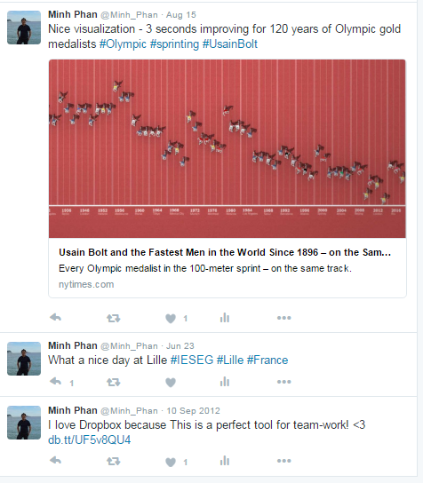
Twitter API, Tweets Data
Twitter data
Data including
Tweet (text, 140 characters)
Profile picture (image)
Some user information (text, location, self-description, etc.)
Account information (number of followers, following, etc.)
Pros
Tons of free data
Can access other accounts, no need to be their friends
Cons
No gender, no birthday, no country
Location is free text, some are unreal
Spamming accounts
Enterprise API

Slide 12
Twitter API, Tweets Data
Twitter data, some statistics
187k tweets
105k accounts
Tweets related to London (187k)
Tweet language: en (94%), es (0.4%), de (0.4%), fr (0.3%)
Retweeted: 53%
Geo-location information: 3.1%
Useful tweets: 37% (69k)
Accounts (105k)
Account language: en (84%), es (4%), de (1%), fr (1.6%)
Having user description: 12%
User profile image changed: 98%
Useful accounts: 36% (38k)
→ Losing 63% of tweets
Keep English tweets
Remove duplicate
Remove retweeted
69k tweets
38k accounts
Notes:
User statuses count: avg (26,133), min (1), max (6,556,197)
User followers count: avg (6,691), min (0), max (26,384,012)
User following count: avg (1,492), min (0), max (1,203,333)

Slide 13
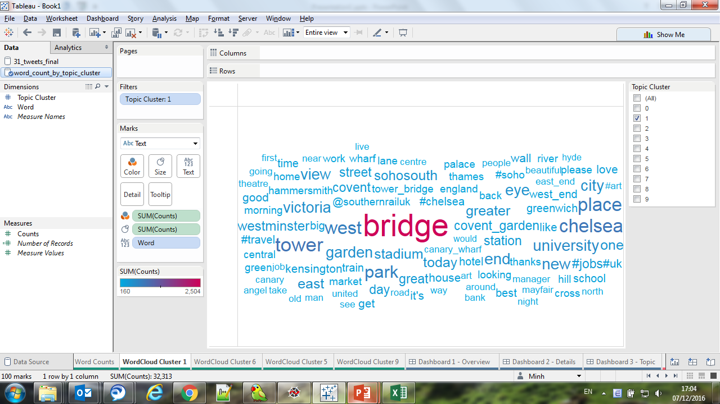
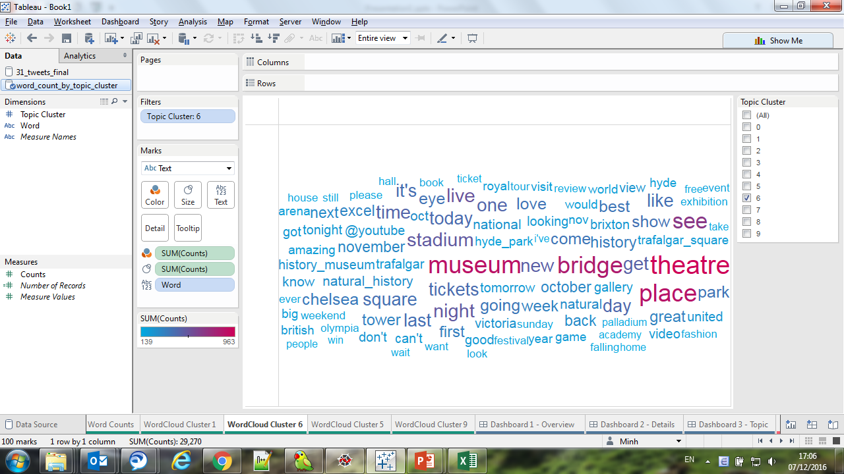
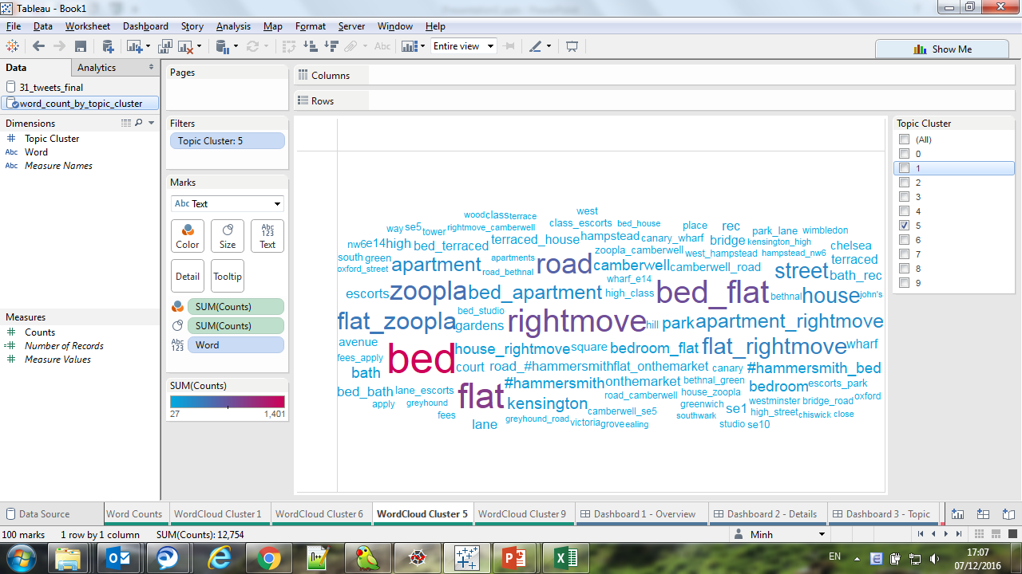
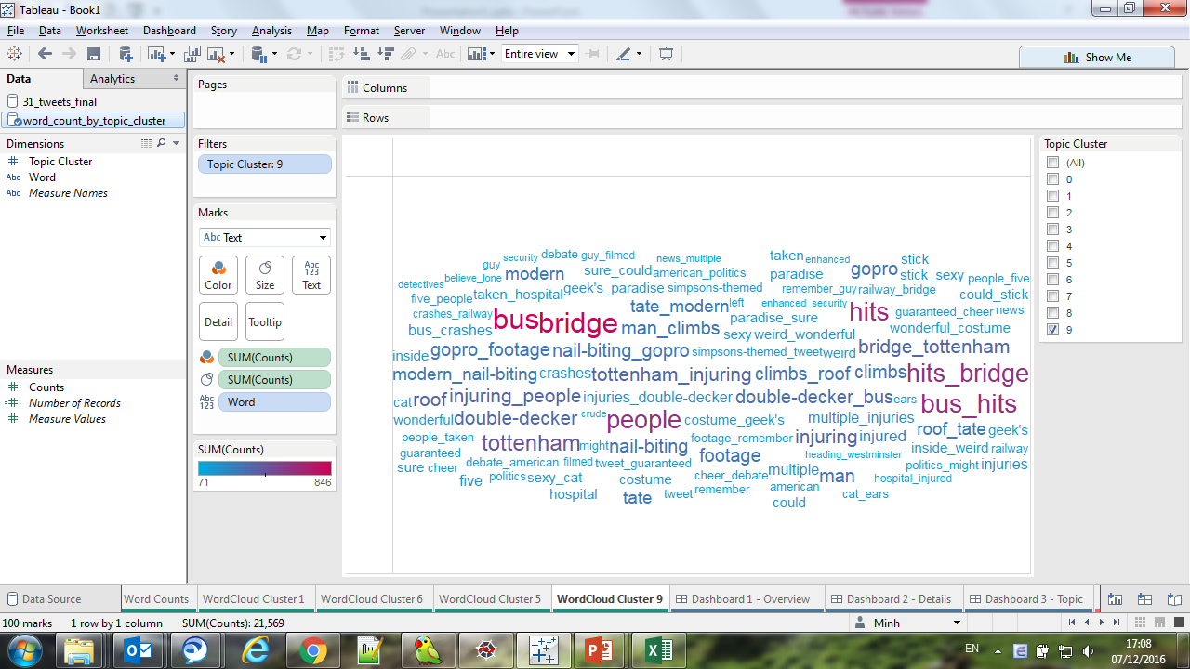
Twitter API, Tweets Data
Twitter data, topics clustering
Vectorize methods
TF-IDF
Word2Vec (Google word2vec, Stanford GloVe)
Clustering methods
K-means
LDA
Evaluating methods
Inertia (sum of distances)
Silhouette score
Gap statistic
→ Clusters are not stable

Slide 14
3
Project Pipeline

Slide 15

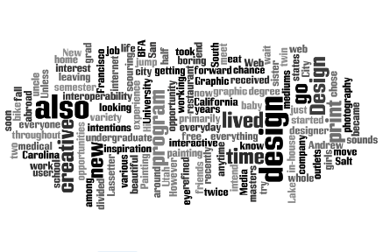


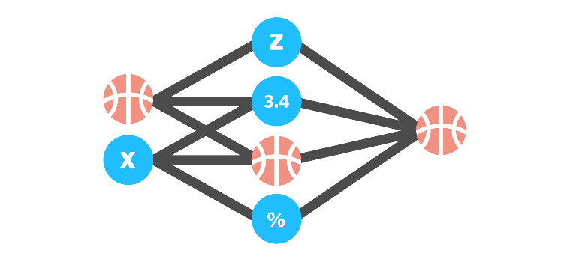



Project Pipeline
Select a city and go with the pipeline
Collecting Data
Classifying Models
Visualizing
1-2 days
1-2 hours
1-2 hours
vs
Gender, Age, Sentiment
Individual vs Organisation
Notes:
3 characteristics of Twitter data:
Many topics
Noise (language, retweeted)
Organizational (spam)

Slide 16
Project Pipeline
Select a city and go with the pipeline
Collecting Data
Classifying Models
Visualizing
TripAdvisor Web Scrapping
(Get tourism locations)
*
Combine Results
(Gender + Age + Sentiment)
Gender Model
(Male or Female?)
*
Twitter Download
(Separate JSON files)
Account Types Filter
(Individual vs. Organization tweets)
Additional Enrich Tweets Data
(Time, Geo info)
*
Age Group Model
(How old they are?)
Tweets JSON Convert
(Extract and clean JSON)
Enrich Tweets Data
(Get more tweets and profile images)
Topics Clustering
(How many topics?)
*
Sentiment Model
(Positive, Negative?)
Tweets Cleansing
(Pre-processing text)
Tableau Dashboard
(Business questions?)
* Machine learning model
Notes:
Explain Enrich Tweets Data step

Slide 17
4
Classification Models

Slide 18
Project Pipeline
Select a city and go with the pipeline
Collecting Data
Classifying Models
Visualizing
TripAdvisor Web Scrapping
(Get tourism locations)
Combine Results
(Gender + Age + Sentiment)
Gender Model
(Male or Female?)
*
Twitter Download
(Separate JSON files)
Account Types Filter
(Individual vs. Organization tweets)
Additional Enrich Tweets Data
(Time, Geo info)
Age Group Model
(How old they are?)
Tweets JSON Convert
(Extract and clean JSON)
Enrich Tweets Data
(Get more tweets and profile images)
Topics Clustering
(How many topics?)
Sentiment Model
(Positive, Negative?)
Tweets Cleansing
(Pre-processing text)
Tableau Dashboard
(Business questions?)
* Machine learning model

Slide 19
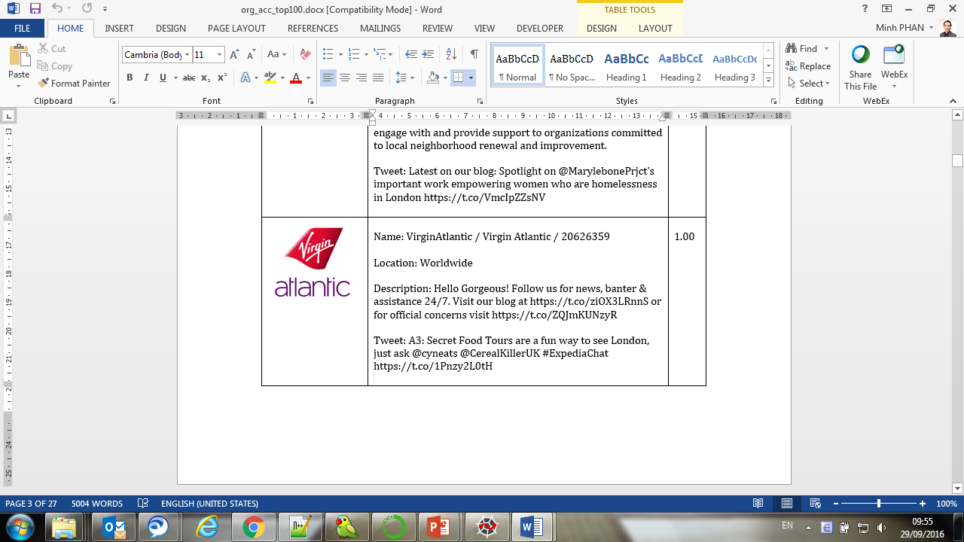
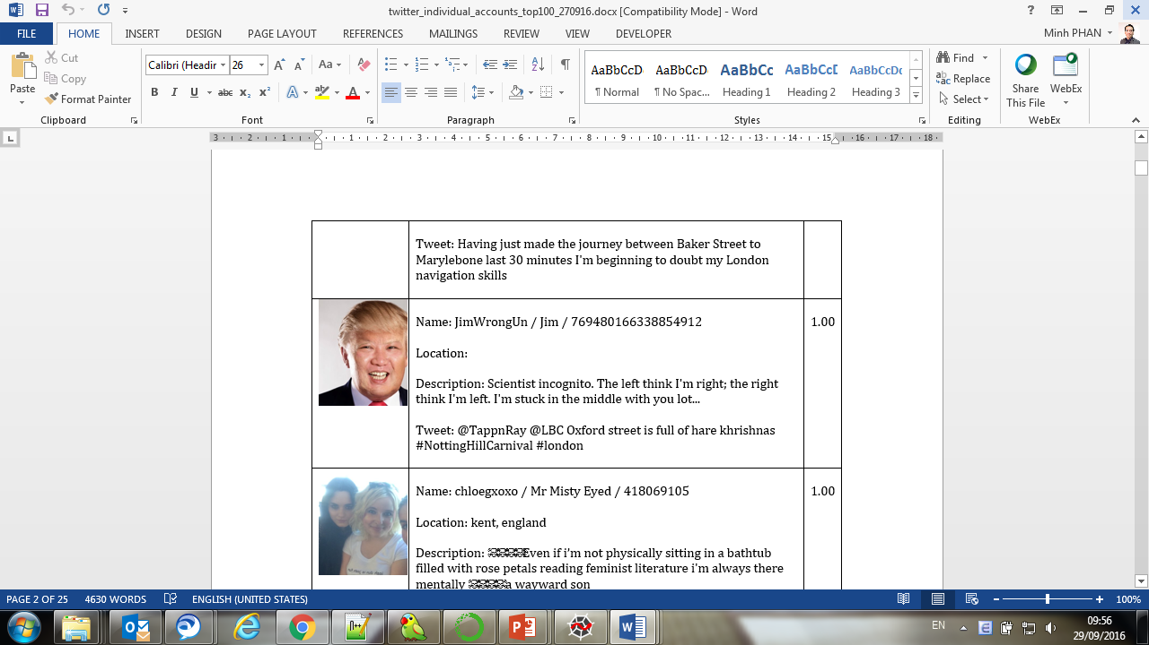
Classification Models
Model 1: Account types classification model
Training data
Uniform sampling Twitter accounts, hand labelling 2,783 accounts (i.e. individual, organization, unknown)
Features
Image features: (43 features)
Texture
Luminance (contrast)
HSV (hue, saturation, brightness, pleasure, arousal, dominance
Itten’s features
Text features: (vector 300 dimension)
Google Word2Vec
Notes:
Note: no data → find a way to create training data → hand labeling Twitter accounts

Slide 20
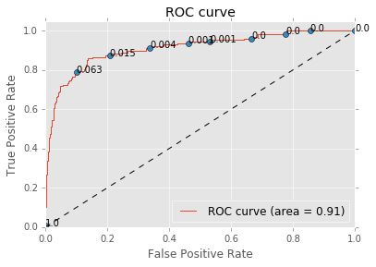
Classification Models
Model 1: Account types classification model
ML model
XGBoost + GridSearchCV
Evaluation
AUC: 0.91
F1-score: 0.89
Accuracy: 90%

Slide 21
Project Pipeline
Select a city and go with the pipeline
Collecting Data
Classifying Models
Visualizing
TripAdvisor Web Scrapping
(Get tourism locations)
*
Combine Results
(Gender + Age + Sentiment)
Gender Model
(Male or Female?)
Twitter Download
(Separate JSON files)
Account Types Filter
(Individual vs. Organization tweets)
Additional Enrich Tweets Data
(Time, Geo info)
Age Group Model
(How old they are?)
Tweets JSON Convert
(Extract and clean JSON)
Enrich Tweets Data
(Get more tweets and profile images)
Topics Clustering
(How many topics?)
Sentiment Model
(Positive, Negative?)
Tweets Cleansing
(Pre-processing text)
Tableau Dashboard
(Business questions?)
* Machine learning model

Slide 22
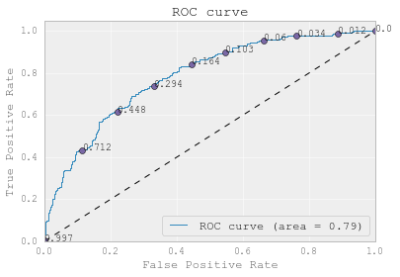
Classification Models
Model 2: Gender classification model
Training data
List of Male and Female names
Look up on Twitter: 1,901 accounts
Features
Gender lexicon, Penn State University
Text features:
Is retweeted
Word length
Count users replies, links, hashtags, emoticons
Count all-capital-words, e.g. AMADEUS
Count long-end words: e.g. greatttttt
Count number of Pronouns, e.g. I, he, she…
ML model
XGBoost + GridSearchCV
Evaluation
AUC: 0.79
F1-score: 0.71
Accuracy: 72%

Slide 23
Project Pipeline
Select a city and go with the pipeline
Collecting Data
Classifying Models
Visualizing
TripAdvisor Web Scrapping
(Get tourism locations)
Combine Results
(Gender + Age + Sentiment)
Gender Model
(Male or Female?)
Twitter Download
(Separate JSON files)
Account Types Filter
(Individual vs. Organization tweets)
Additional Enrich Tweets Data
(Time, Geo info)
*
Age Group Model
(How old they are?)
Tweets JSON Convert
(Extract and clean JSON)
Enrich Tweets Data
(Get more tweets and profile images)
Topics Clustering
(How many topics?)
Sentiment Model
(Positive, Negative?)
Tweets Cleansing
(Pre-processing text)
Tableau Dashboard
(Business questions?)
* Machine learning model

Slide 24
Classification Models
Model 3: Age group classification model
Training data
Look up the term “Happy birthday [age] to me”
1,477 Twitter accounts
Features
Age lexicon, Penn University
Text features:
Is retweeted
Word length
Count users replies, links, hashtags, emoticons
Count all-capital-words, e.g. AMADEUS
Count long-end words: e.g. greatttttt
Count number of Pronouns, e.g. I, he, she…
ML model
XGBoost + GridSearchCV
Evaluation
F1-score: 0.63
Accuracy: 62%

Slide 25
Project Pipeline
Select a city and go with the pipeline
Collecting Data
Classifying Models
Visualizing
TripAdvisor Web Scrapping
(Get tourism locations)
Combine Results
(Gender + Age + Sentiment)
Gender Model
(Male or Female?)
Twitter Download
(Separate JSON files)
Account Types Filter
(Individual vs. Organization tweets)
Additional Enrich Tweets Data
(Time, Geo info)
Age Group Model
(How old they are?)
Tweets JSON Convert
(Extract and clean JSON)
Enrich Tweets Data
(Get more tweets and profile images)
Topics Clustering
(How many topics?)
*
Sentiment Model
(Positive, Negative?)
Tweets Cleansing
(Pre-processing text)
Tableau Dashboard
(Business questions?)
* Machine learning model

Slide 26

Classification Models
Model 4: Sentiment classification model
Training data
SemEval Workshop 2013 (5,670 train, 851 test)
SESAMm sentiment dataset (6,588 train, 1,044 test)
Features
Lexicons:
NRC Hashtag Sentiment Lexicon
Sentiment140 Context Lexicon
MPQA Lexicon
NRC Word-Emotion Association Lexicon
Opinion Lexicon English
Counts:
Long-end words, e.g. soooooo
Continuous exclamation marks, e.g. !!!???
Number of hashtags
Upper-case words, e.g. AMADEUS
Word2Vec:
Twitter Word Clusters Lexicon (CMU)
Google Word2Vec model
Ironic or Neutral
“The view is bad but the food is great.”
"Excellent! This day couldn't start off any better!“
“See London's reflection shimmers on its dark waters! Paddle down river to see the Houses of Parliament in all...”

Slide 27
Classification Models
Model 4: Sentiment classification model
ML model
XGBoost + GridSearchCV
Evaluation
F1-score 0.66
Accuracy: 67%
Notes:
https://docs.google.com/spreadsheets/d/1Xe3lCi9jnZQiZW97hBfkg0x4cI3oDfztZPhK3TGO_gw/pub?output=html#

Slide 28
5
Product Prototype

Slide 29
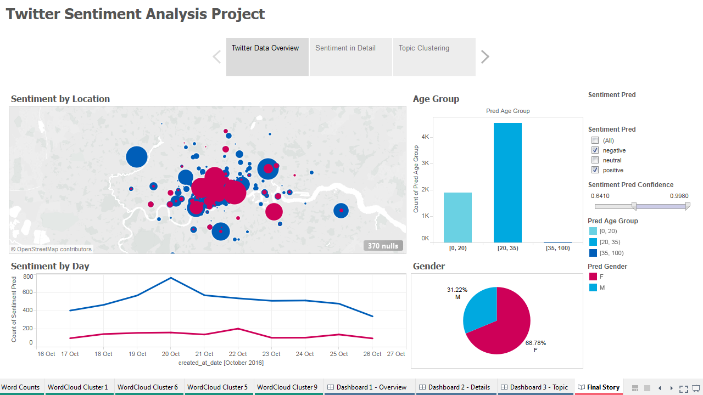
Product Prototype

Slide 30
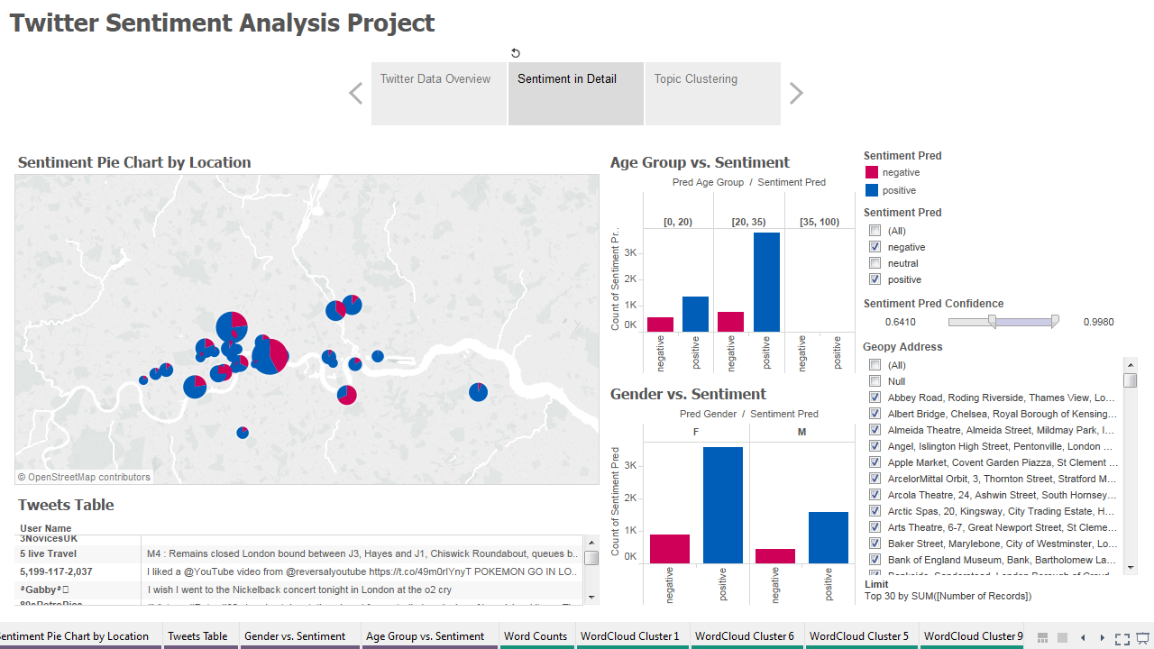
Product Prototype

Slide 31
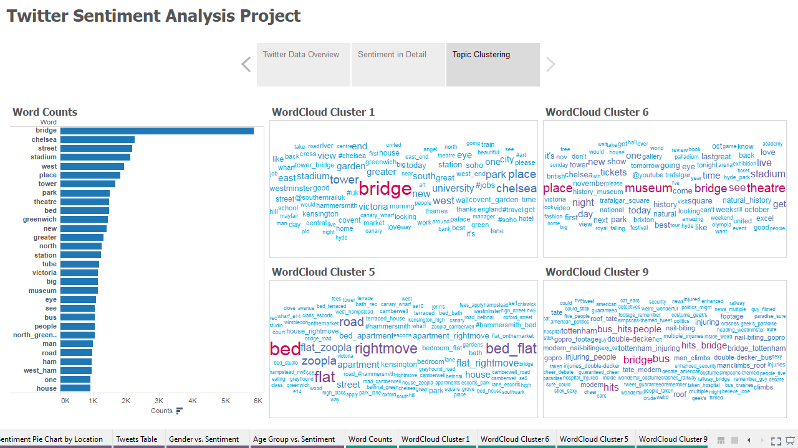
Product Prototype

Slide 32
6
Wrap-up

Slide 33
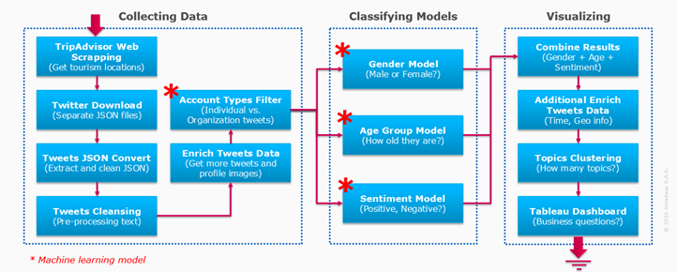
Wrap-up
Things we did
Built a complete pipeline for the project, easy to add or improve modules in the future
Built an Account Types classification model, AUC=0.91, Accuracy=90%
Built a Gender classification model, AUC=0.79, Accuracy=72%
Built a Age Group classification model, F1-Score=0.63, Accuracy=62% (21% better than a dummy model)
Built a Sentiment Classification model, F1-Score=0.66, Accuracy=67%, better than commercial APIs (e.g. Microsoft Cognitive API, AYLIEN API), free API (e.g. text-processing.com API)
Notes:
Note: easy to reuse in other project, PNR Remark text analyzing

Slide 34

Wrap-up
Things to improve
More data to improve the 4 models
More ways to collect data, e.g. “London” :)
Buy data from Twitter enterprise API (GNIP)
Other training data sources, e.g. Sentiment140 http://help.sentiment140.com/for-students/
Upgrade Machine Learning model
Deep learning model to improve Age and Gender classification
Ensemble 16 models can increase Sentiment classification model’s F1-Score up to 0.70
Add company/user history database to save time and avoid duplicated work
Tweak decision threshold to fit with the local data distribution, e.g. percentage of
organization vs. individual accounts is different by city
Notes:
http://help.sentiment140.com/for-students/

Slide 35

#ThankYou! and #MerryChristmas!
You can follow us on:
AmadeusITGroup
amadeus.com/blog
amadeus.com

Slide 36
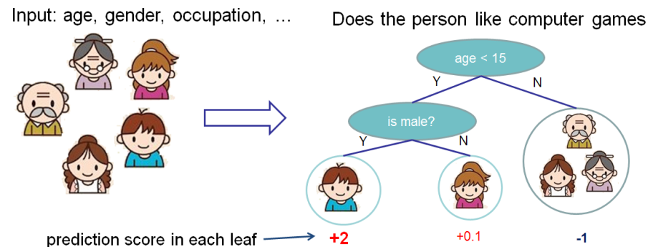
Appendix 1
XGBoost - Extreme Gradient Boosting
Tree Ensemble
Notes:
https://www.youtube.com/watch?v=0Xc9LIb_HTw
http://homes.cs.washington.edu/~tqchen/pdf/BoostedTree.pdf
http://xgboost.readthedocs.io/en/latest/model.html

Slide 37
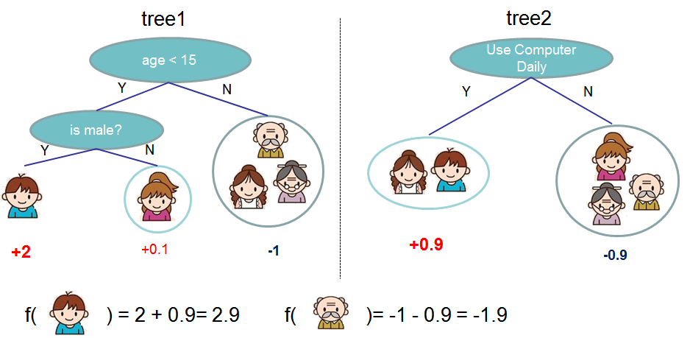
Appendix 1
XGBoost - Extreme Gradient Boosting
Tree Ensemble

Slide 38
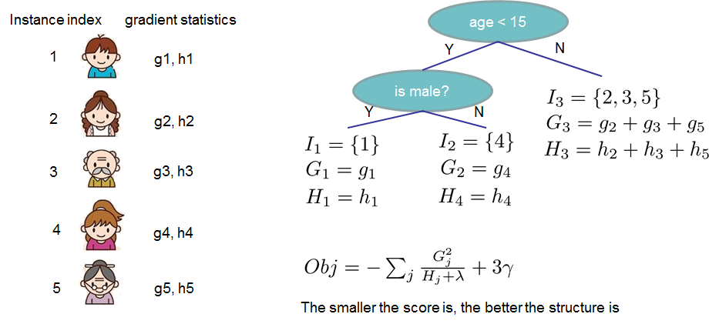
Appendix 1
XGBoost - Extreme Gradient Boosting
Gradient Boosting

Slide 39
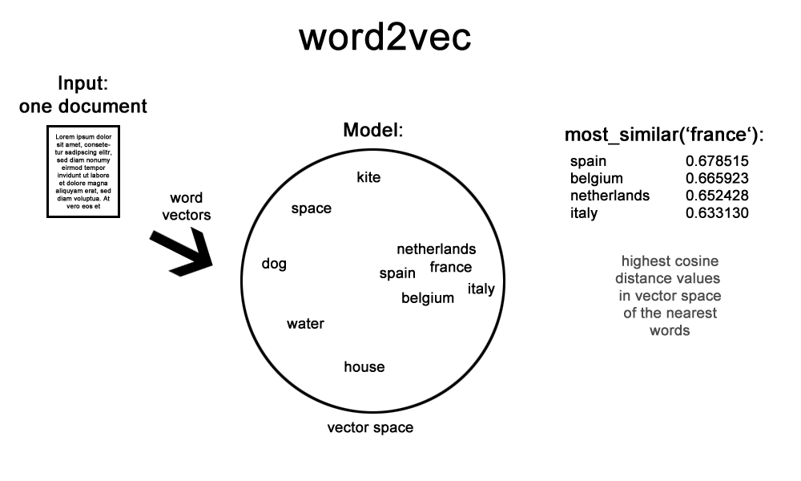
Appendix 2
Word2Vec
Represent a word by a vector (vectorize)
Reduce the data dimension compare with other word frequency method (TF-IDF)
Better results most of the time
Notes:
https://youtu.be/T8tQZChniMk

